Slide 1

ARMCI
By Cameron Cross

Slide 2
What is ARMCI?
Aggregate Remote Memory Copy Interface
ARMCI provides a general-purpose, efficient, and widely portable remote memory access operations optimized for contiguous and noncontiguous (strided, scatter/gather, I/O vector) data transfers.
ARMCI includes a set of atomic and mutual exclusion operations.

Slide 3
What Does ARMCI Do?
ARMCI exploits native network communication interfaces and system resources (such as shared memory) to achieve the best possible performance of the remote memory access/one-sided communication.
It exploits high-performance network protocols on clustered systems. Optimized implementations of ARMCI are available for the Portals, Myrinet (GM), Quadrics, Infiniband (using OPENIB and Mellanox verbs API), and Ethernet.

Slide 4
How Does it Work?
blocking and nonblocking data transfer operations
aggregation of small data transfers into larger messages to reduce sensitivity to network latency
register originated data transfers
atomic and synchronization operations
memory management operations
Processor Groups
Global procedure calls (prototype)
weakly consistent memory model

Slide 5
Blocking and Non-blocking Data Transfer Operations
A get operation transfers data from the remote process memory to the calling process local memory.
A put operation transfers data from the local memory of the calling process to the memory of a remote process.
The non-blocking API, is derived from the blocking interface by adding a handle argument that identifies an instance of the non-blocking request.
All the non-blocking transfer functions are prototyped to work as transfers with both "explicit" and "implicit” handles.

Slide 6
Coalescing small messages (trading latency for bandwidth)
Aggregation of requests is another mechanism for improving latency tolerance. Multiple nonblocking data transfers (put/get requests) can be aggregated into a single data transfer operation in order to improve the data transfer rate.
Especially, if there are multiple data transfer requests of small message sizes, aggregating those requests into a single large request reduces the latency, thus improving performance.
The aggregate data transfer operation is also independent of the type of put/get operation.
For example, it can be a combination of regular, strided or vector put/get operations. There are two types of aggregation available:
explicit aggregation, where the multiple requests are combined by the user through the use of strided or generalized I/O vector data descriptor.
implicit aggregation, where the combining individual requests are performed by ARMCI.

Slide 7
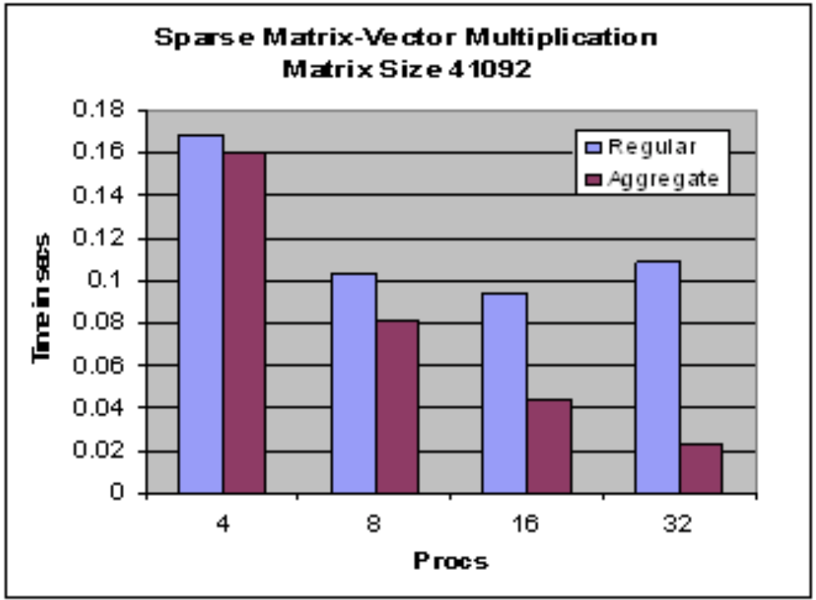
Aggregate VS Non-Aggregate

Slide 8
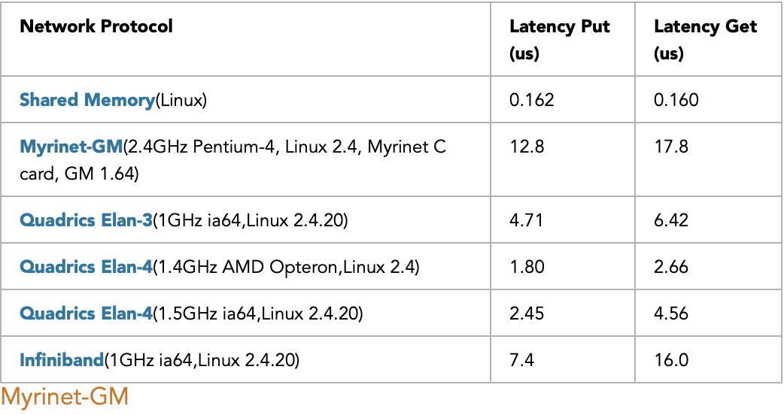
System Performance

Slide 9
ARMCI and MPI
ARMCI is compatible with MPI.
However, by design it is impartial to a selection of the message-passing libraries in the user program.
In addition to MPI, on some platforms ARMCI was also used with PVM and TCGMSG message-passing libraries.

Slide 10
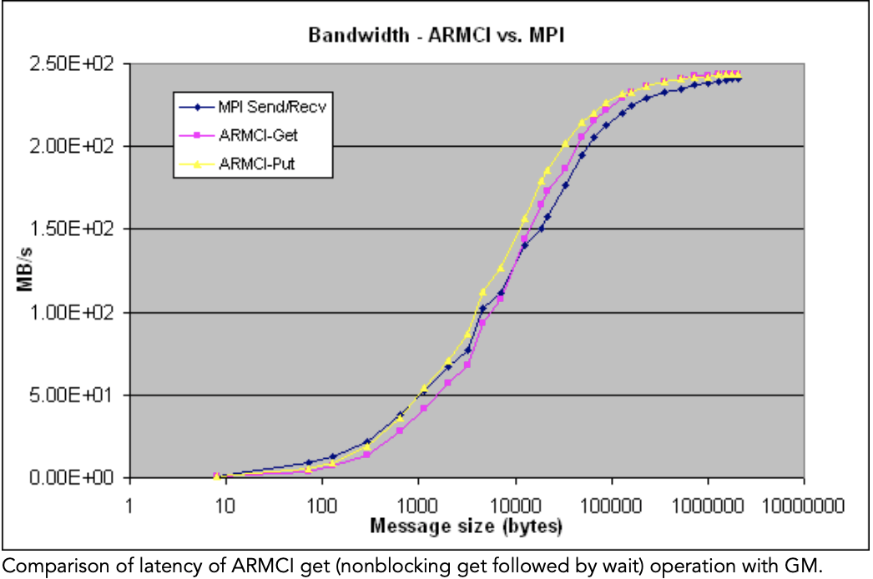
Against MPI

Slide 11
Who Uses ARMCI?
ARMCI is available on the following platforms:
IBM BlueGene/P, BlueGene/L and SPs (based on LAPI)
Cray XT
Unix workstations and servers: Sun, SGI, HP, IBM, Linux
Clusters of Unix and Windows NT workstations/servers, including the HP/Quadrics Alphaserver cluster and Quadrics Linux clusters
Fujitsu and NEC Systems
Cygwin and Apple (MACX)

Slide 12
How Useful is ARMCI?
ARMCI has been used to:
implement the Global Arrays library
implement GPSHMEM, a portable version of the Cray SHMEM library (Ames Lab)
implement nxvtal server in TCGMSG
implement a Co-Array Fortran compiler at Rice U.

Slide 13
Example
int ARMCI_Put(void* src, void* dst, int bytes, int proc)
PURPOSE: Blocking transfer of contiguous data from the local process memory (source) to remote process memory (destination).
ARGUMENTS:
src - Source starting address of the data block to put.
dst - Destination starting address to put data.
bytes - amount of data to transfer in bytes.
proc - Remote process ID (destination).
RETURN VALUE:
zero - Successful.
other value - Error code (described in the release notes).
int ARMCI_Get(src, dst, bytes, proc)
PURPOSE: Blocking transfer of contiguous data from the remote process memory (source) to the calling process memory (destination).
ARGUMENTS:
src - Source starting address of the data block to get.
dst - Destination starting address to get the data.
bytes - amount of data to transfer in bytes.
proc - Remote process ID (destination).
RETURN VALUE:
zero - Successful.
other value - Error code (described in the release notes).

Slide 14
Work Cited
https://hpc.pnl.gov//armci/
https://hpc.pnl.gov/armci/capabilities.shtml
https://hpc.pnl.gov/armci/documentation.htm#copy
https://hpc.pnl.gov/armci/performance.shtml

